Slide 1
Predicting Song Popularity on Spotify
By Anantha Rao, Xingrong Chen, and Desmond Fung

Slide 2
Introduction
With the increasing prevalence of streaming platforms for music, learning about the music industry becomes more and more about listener behavior on these platforms.
Our project involves a data set from spotify with 19,000 songs and 13 features related to the song quality(tempo, key, danceability, runtime,etc..) as well as a rating of how popular the song is on spotify(related to the number of streams).
Notes:
With the nature of online music and streams it’s easy to collect data. So we have a dataset with 19,000 songs and spotify-made features about the songs

Slide 3
Motivation/Goals
These questions may offer insight for record labels and artists in deciding to publish songs. It may also reveal patterns in human music consumption that are interesting for other reasons.
(How well) Can we predict whether a song will be popular? What are the acoustic qualities of a song that make it popular?
Notes:
Our goals for this project are,

Slide 4
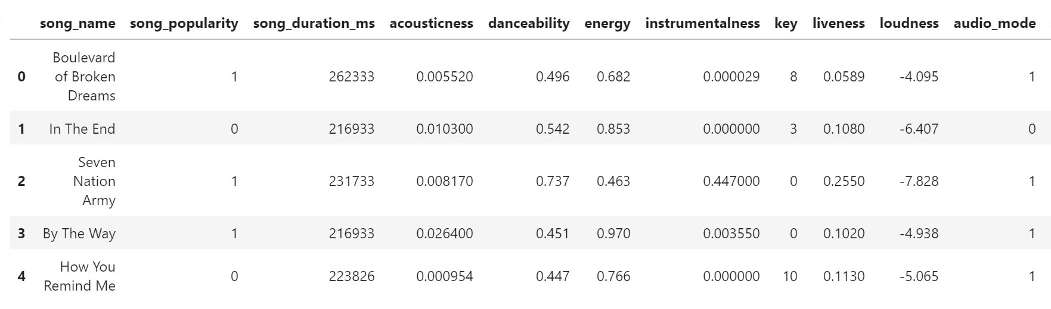
Our Dataset
We collected the data from website https://www.kaggle.com/edalrami/19000-spotify-songs?select=song_data.csv
14 feature with 18835 observations
1 feature measure the popularity of songs, other features describe the characterization of songs like song duration, acousticness, loudness, tempo, etc.
3 categorical variables (like keys, time signature and audio mode) and 11 numeric variables

Slide 5
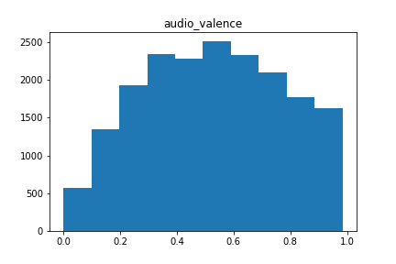
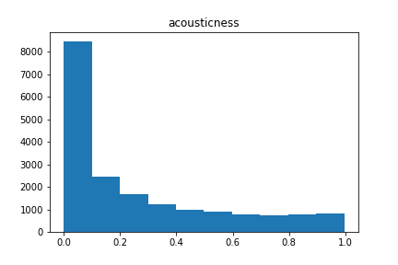
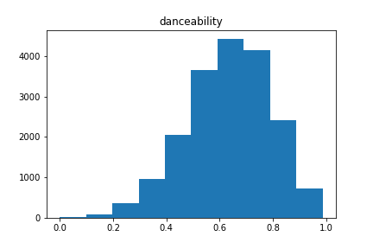
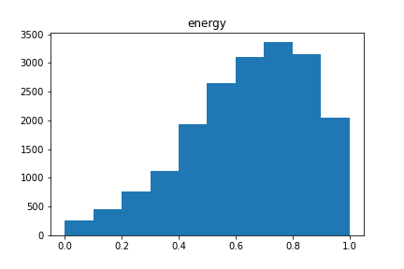
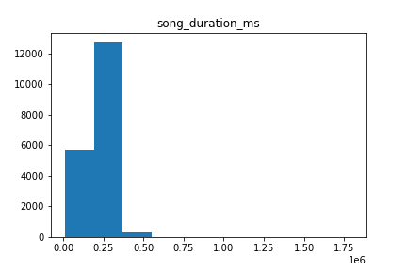
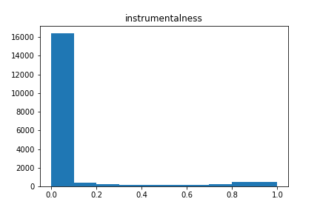
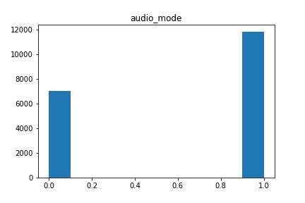
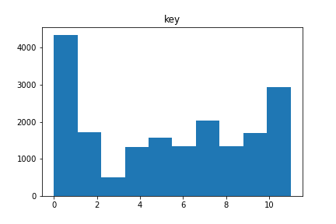
Feature distribution

Slide 6
Preprocessing
How to define popularity?
If a song’s popularity measurement is greater than 80% songs in our dataset, then we treat it as a ‘popular’ song. Otherwise, the song is ‘unpopular’
What are we trying to predict?
We try to use features except ‘song_popularity’ in the dataset to identify whether a song is popular or not by machine learning algorithm.

Slide 7
Preprocessing
Splitting the 85% of original data set as train set while the rest are test set.
Keep the distribution of popular song in two subsets are the same as the original dataset by using stratify method

Slide 8
Models
Logistic Regression
kNN
Decision Tree
Random Forest

Slide 9
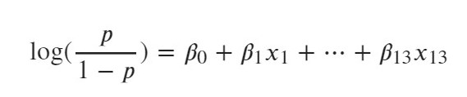
Logistic regression
Since after our preprocessing, we only have the song with ‘popular’ label and the song with ‘unpopular’ label. So we treat it as a binary data, and try to use logistic regression model to estimate the probability of a song will be popular, using the default threshold in sklearn, if the estimated probability greater than 0.5, then the model will predict the song is popular

Slide 10
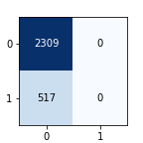
Result
The logistic model predict all the songs are unpopular
All the songs has less 0.5 probability to be popular
Since the prediction given by logistic model is not quite useful, so we look at other result given by this model.

Slide 11
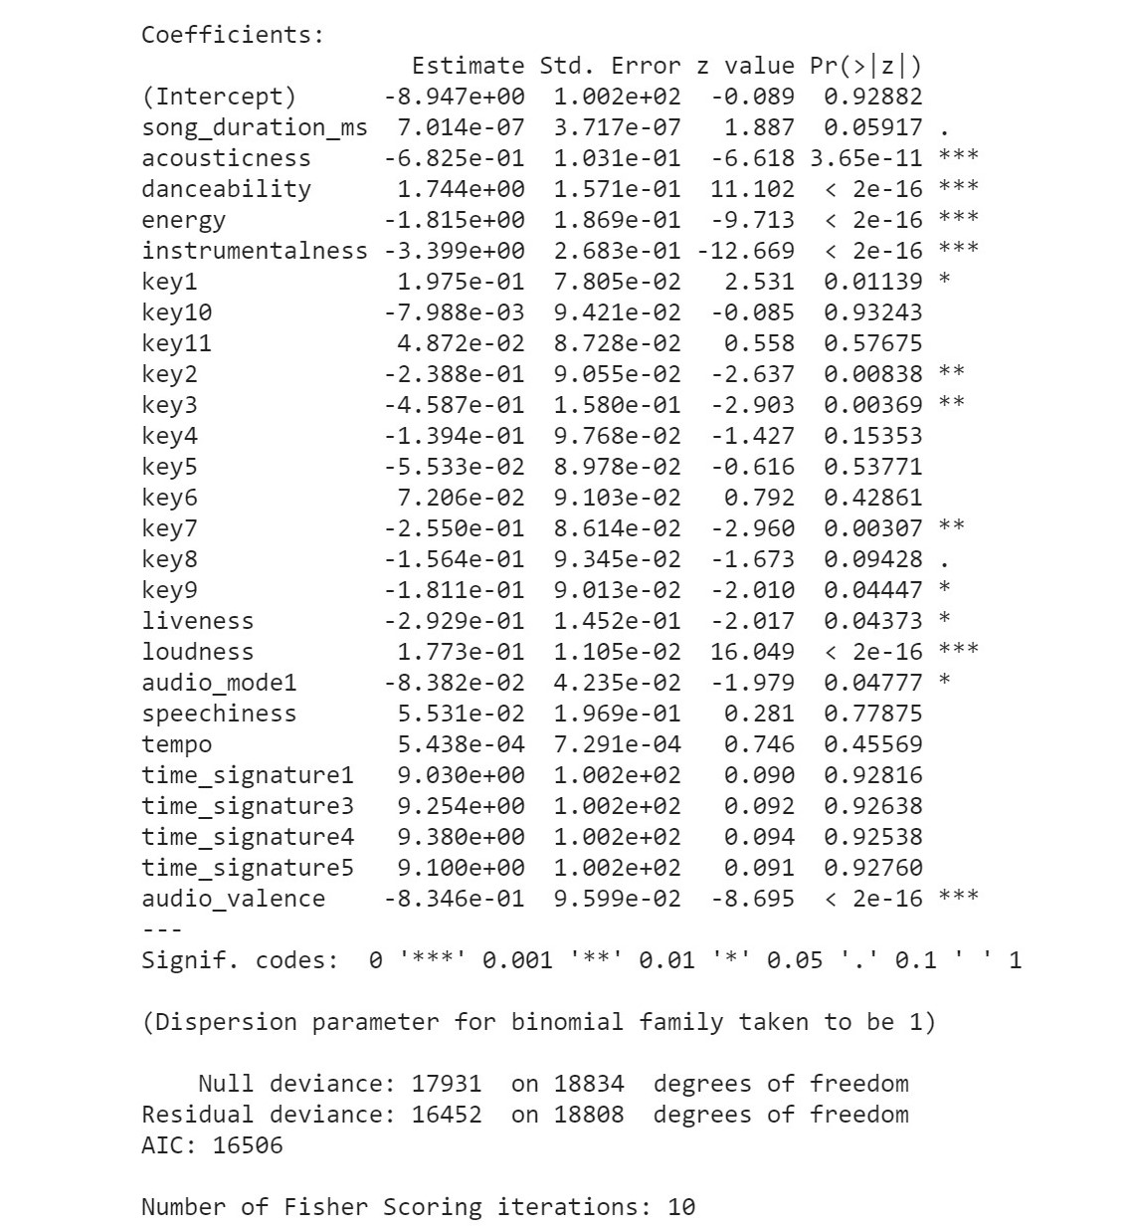

Slide 12
KNN
Our group also attempted to utilize K -nearest neighbors (KNN) to predict song popularity
Advantages
The algorithm is simple and easy to implement.
There’s no need to build a model, tune several parameters, or make additional assumptions.
The algorithm is versatile and can used for both classification, regression
Notes:
Another model we attempted is the K-nearest neighbor. It is one of the simplest classification algorithm that can be used to solve both classification and regression problem. It can give highly competitive results even with such simplicity and we expect it to perform better than our logistic regression model.
One of the most important task in kNN is choosing the correct number of neighbors. A plot of kNN k values vs accuracy is provided where we attempt several Ks value. We can see that kNN performs the best when the number of neighbors is set to 1 in which we achieve 88% test set accuracy..
KNN has a major drawback of becoming significantly slows as the size of that data in use grows. Another potential drawback is that it is particularly susceptible to the curse of dimensionality. With 13 feature values such as in our dataset, kNN will take a large portion of the hypervolume into consideration to find k nearest neighbor and hence affect the trustability of the model.

Slide 13
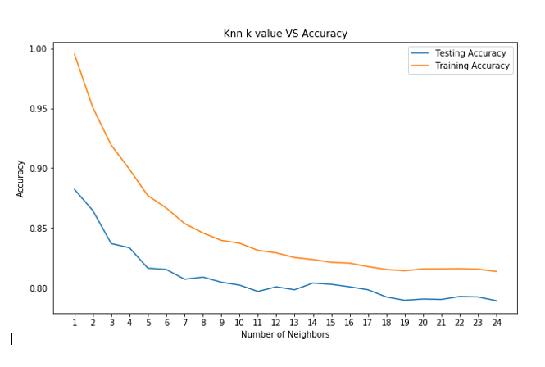
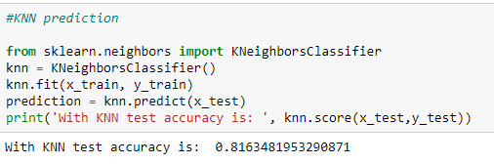
KNN
Figure with KNN performance on test set
Potential drawback: Curse of Dimensionality
becoming significantly slower as the size of the data grows
take a large portion of the hypervolume into consideration to find k nearest neighbor
Notes:
Another model we attempted is the K-nearest neighbor. It is one of the simplest classification algorithm that can be used to solve both classification and regression problem. It can give highly competitive results even with such simplicity and we expect it to perform better than our logistic regression model.
One of the most important task in kNN is choosing the correct number of neighbors. A plot of kNN k values vs accuracy is provided where we attempt several Ks value. While only achieving 81.6% accuracy when no hyperparameter is specify, kNN performs the best when the number of neighbors is set to 1 in which we achieve 88% test set accuracy.
KNN has a major drawback of becoming significantly slows as the size of the data in use grows. Another potential drawback is that it is particularly susceptible to the curse of dimensionality. With 13 feature values such as in our dataset, kNN will take a large portion of the hypervolume into consideration to find k nearest neighbor and hence affect the trustability of the model.

Slide 14
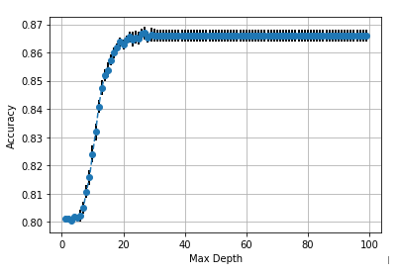
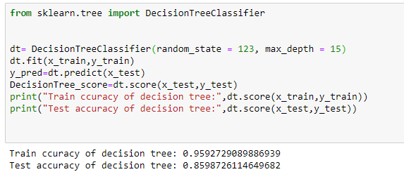
Decision Trees
The Decision Tree model was build to predict song popularity based on the given features
Set max_depth = 15
Model performed better than KNN, logistic regression perform the worst
Accuracy tends to stabilize as max_depth grow larger than 20
Decision Tree Performance with different max_depth
Notes:
We also build a decision tree to evaluate its predictive performance against other models. We initially tried setting max_depth as 15 because we have 19,000 datapoint and the log of that is 14.2, so 15 would be a good estimator if we want to cover each leaf node at least once . With a max depth of 15, our decision tree perform slightly worse than KNN with a test accuracy of 86%. We then decided to plot accuracy against different max_depth to see how our decision tree model performs with different max_depth. An intriguing observation in this plot is that accuracy tends to stabilize as max_depth grow larger than 20, it wouldn’t make much accuracy difference

Slide 15
Ensemble Methods
Methods explored:
Bagging
Random Forests

Slide 16
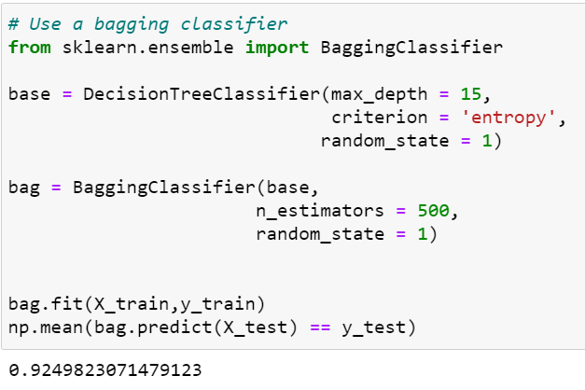
Bagging
We carried out bagging with 500 Decision trees with the same depth as our base DT estimator before(depth = 15).
Decided on hyperparameter manually using the ‘%timeit’ function
Notes:
For Bagging, we used a base estimator of a Decision Tree with max depth = 15, we tried a couple different total number of estimators and settled on 500. Because between each of our computers it was the highest that didn’t exceed two minutes of training time. This was sort of a rough experiment done with the %timeit function.
We used 500 estimators and obtained test accuracy of ~92.5%

Slide 17
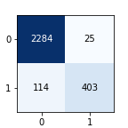
Random Forest
100 trees in the forest
Using Gini impurity for information gain
No max depth of trees
Default number of features to consider the split
93.98% accuracy on test set.

Slide 18
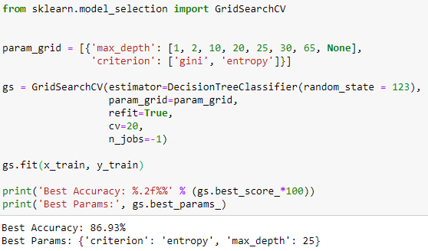
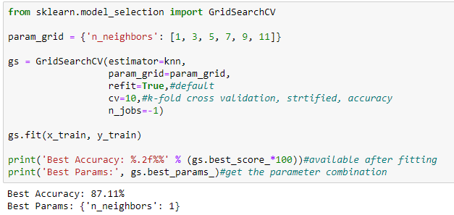
Grid Search
Figure with KNN performance on test set****
+
Decision Tree Performance*****
+
Bagging Performance
+
Random Forest Performance
Grid Search is used to see if there was a way to improve the accuracy of our base models
KNN with Grid Search
Decision Tree with Grid Search
Notes:
Grid search is the process of performing hyper parameter tuning in order to determine the optimal values for a given model. We applied grid search in KNN and Decision Tree, using the recommended cross-validation splitting of 10 and other parameter from lecture. Noticeable improvement were made with Grid search. Our kNN model went from 81.6 to 87% accuracy with 1 nearest neighbors while our decision tree model went from 86 to 87% accuracy with entropy as information gain and a max_depth of 25.

Slide 19
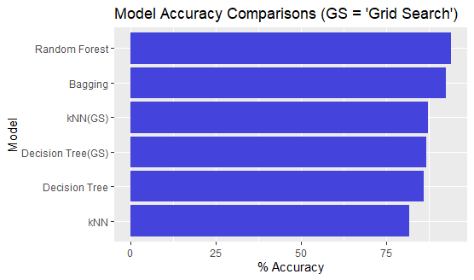
Model Comparisons (Van)

Slide 20
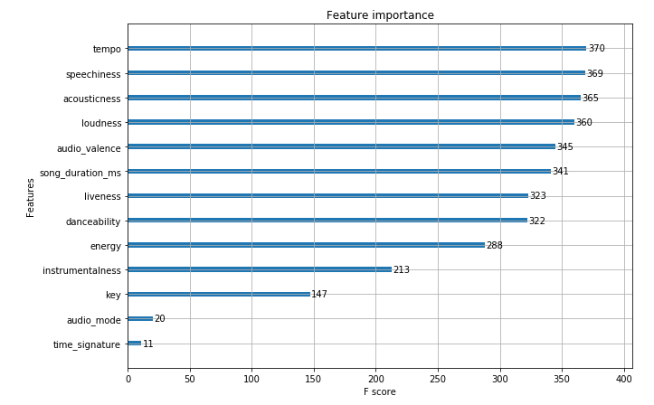
Feature importance(Van)
In asking about which acoustic qualities are most important in determining song popularity, we implicitly require a level of interpretability
We analyze feature importance with XGboost python package and the plot_importance function to gain an understanding of the popular song qualities

Slide 21
Conclusion
The model that performed best was :
Random Forest Classifier
Examining other analysis of this data (such as on Kaggle)supported this classifier as well showing power of this model
Other Considerations:
How prevalent is a song on social media (Tik Tok, etc.)?

